Slide 1


BRIDGE
ASL to text and speech, wherever you go.
Everyday moments like ordering coffee or asking for directions shouldn’t require an interpreter.
PRESENTED BY:
CEG 4913 | Group 4
Notes:
AIDAN (0:00 to 0:40)
Imagine walking into a cafe and not being able to order a coffee, because the person behind the counter doesn't understand you. For many ASL users, that's everyday life, and interpreters aren't there for quick moments like ordering coffee or asking for directions. We're Group 4, and we're building Bridge: wearable gloves that translate ASL into text and speech in real time. I'm Aidan. I worked on our hardware design and sensor calibration, and I put together the list of 50 to 100 signs we're targeting, focusing on the everyday words that matter most in those quick interactions.

Slide 2
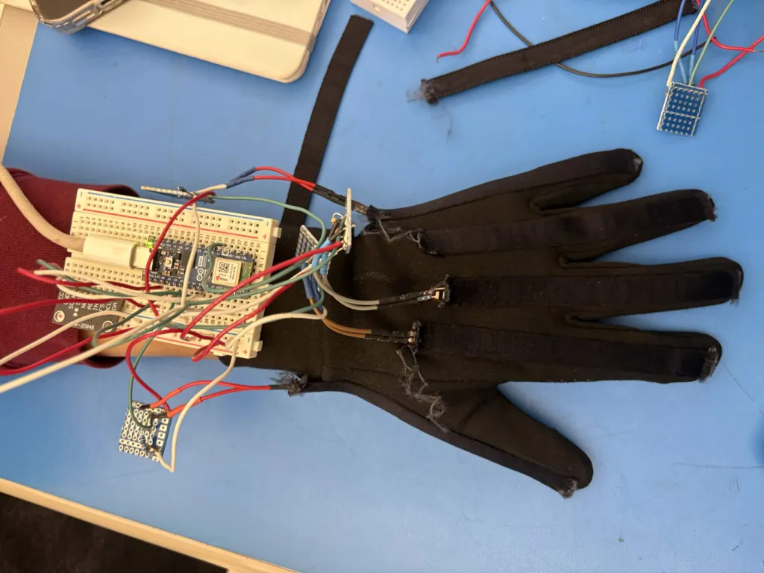
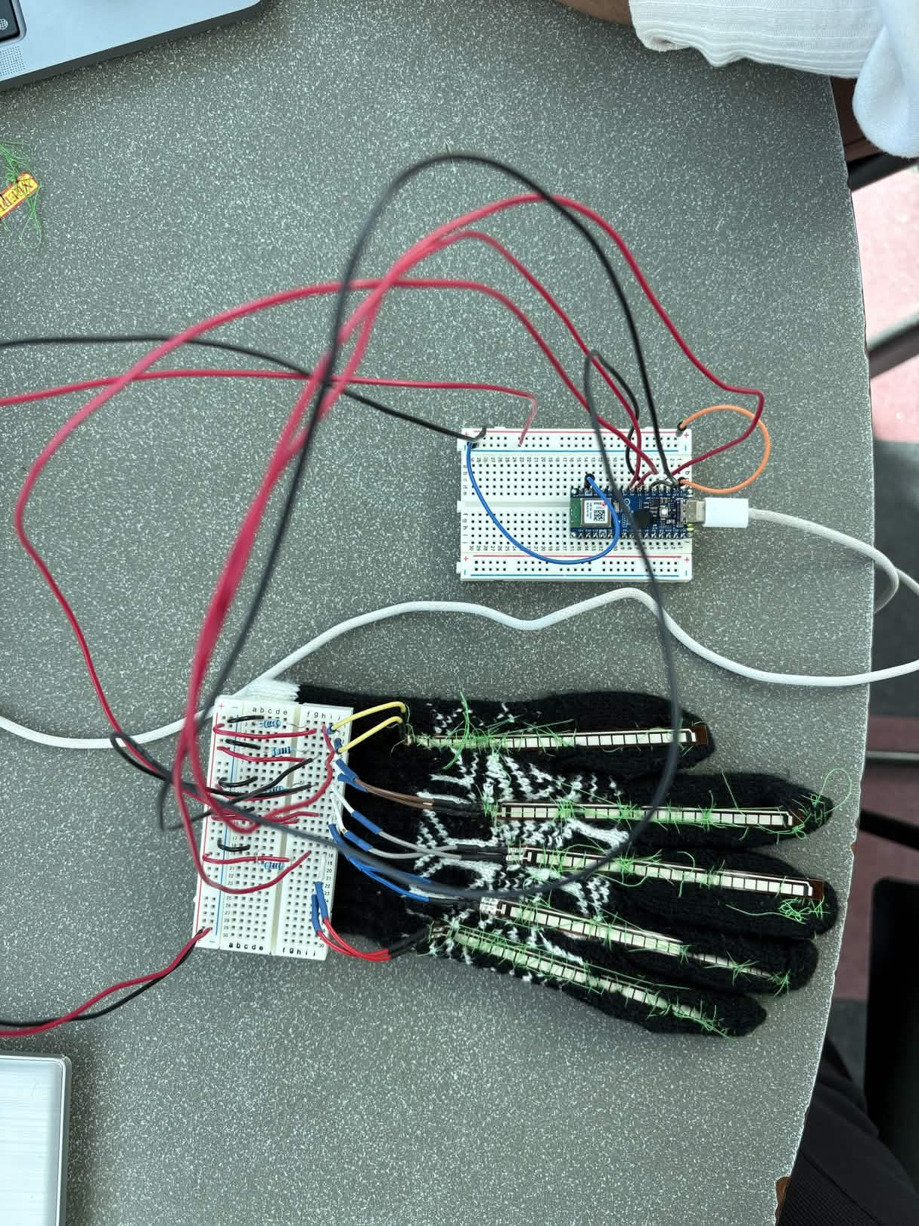
UPDATE: BUILDING THE GLOVE
Currently: Building 2nd glove, finishing soldering
Notes:
WILLIAM (0:40 to 1:40)
I'm William. Our teammate Krisha couldn't be here today, but she's the one who made this wearable. She designed the wiring layout, sewed the sensors onto the glove, and built our database. My job was getting data off the glove reliably. I calibrated the sensors, set up the ESP32 to transmit readings over Bluetooth, and tested our 9-axis motion sensors with the Raspberry Pi. Testing also showed us our first flex sensors had too little range to tell signs apart, so we upgraded, and the new sensors gave us a much cleaner signal.

Slide 3
UPDATE: UI
Currently: Using glove for data collection for ML
Notes:
WILLIAM (0:40 to 1:40)
I'm William. Our teammate Krisha couldn't be here today, but she's the one who made this wearable. She designed the wiring layout, sewed the sensors onto the glove, and built our database. My job was getting data off the glove reliably. I calibrated the sensors, set up the ESP32 to transmit readings over Bluetooth, and tested our 9-axis motion sensors with the Raspberry Pi. Testing also showed us our first flex sensors had too little range to tell signs apart, so we upgraded, and the new sensors gave us a much cleaner signal.

Slide 4
UPDATE: 9 axis, Raspberry Pi
Notes:
WILLIAM (0:40 to 1:40)
I'm William. Our teammate Krisha couldn't be here today, but she's the one who made this wearable. She designed the wiring layout, sewed the sensors onto the glove, and built our database. My job was getting data off the glove reliably. I calibrated the sensors, set up the ESP32 to transmit readings over Bluetooth, and tested our 9-axis motion sensors with the Raspberry Pi. Testing also showed us our first flex sensors had too little range to tell signs apart, so we upgraded, and the new sensors gave us a much cleaner signal.

Slide 5
WHAT’S LEFT
1
2
3
4
Data Collection + Model Training
Motion sensing
IMUs capture movement, not just hand shape
Pi Body Unit
Connects to the gloves, runs fully offline and speaks out loud
DECEMBER GOAL: Sign a sentence. Hear it spoken.
Notes:
GAUTHIER (2:35 to 3:15)
I'm Gauthier. Last term, I set up the Raspberry Pi and captured data from our 9-axis motion sensor, and this term I'm connecting the Pi to the gloves. That's the heart of what's next. The Pi becomes a body unit worn at the waist that runs everything locally, with no internet needed, and speaks translations out loud. With a second glove and motion data, Bridge will read movement, not just hand shape, and grow from nine letters to up to 100 words. Our December goal: sign a sentence, and hear it spoken back.

